Slide 1
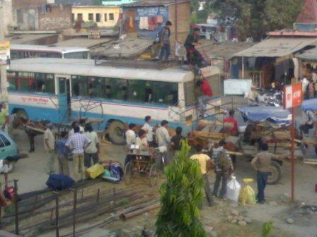
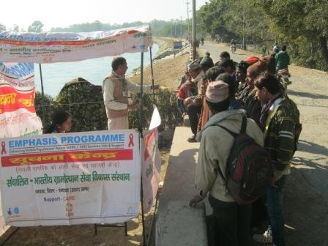
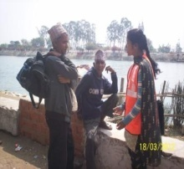
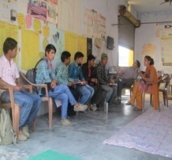
HIV intervention at Indo Nepal Border-Banbasa…It works! Authors: Rokaiya Parween, Bhupendra Verma, Nabesh Bohidar and Tahseen Alam Affiliations: CARE India, Bharatiya Gramotthan Sewa Vikas Sansthan
Introduction:
HIV intervention for cross border migrants at transit points is rare, general understanding is that interventions are not useful as migrants do not have time at transit. Banbasa, provides bus and train connectivity to 800-1000 Nepali migrants for Delhi and other cities, from various districts on daily basis. Interventions at transit, therefore, provide an opportunity to reach large sections of the migrant population. Migrants have to take a rickshaw to travel from the border to the bus-stand, it takes about 20 minutes and waiting time of roughly 20-30 minutes, sometimes even more depending on the bus to take.
Glimpse of Transit….Banbasa Bus stand.
Emphasis Information Kiosk at Indo Nepal border…
Most of the interactions at transit point is one to group as Migrants prefer to move in groups. The intervention strategy adopted are selection of Peer Educators from Local Community and criteria was fixed as those who directly interact with Nepali in their day to day life would be suitable for Peer Educators. Out of 15(9 Rickshaw pullers,2 Tanga pullers,3 Hoteliers & 1 bus conductor)was chosen as Peer Educators. 4 Outreach Workers and 2 DIC Counselors are also in the team. Rickshaws and tangas are the preferred transportations for Nepalis from border to Banbasa bus stand. The outreach staff were selected based on their language proficiency in Nepali, even the DIC counselors were also proficient in Nepali Language.
Information dissemination during interaction with Nepali Mobile Population
Project and Activities:
EMPHASIS developed an intervention model at the transit to target large section of migrants. A Drop in Centre (DIC) been situated near the bus stand has proven to be an important informational and relaxation centre for NMPs. Outreach staff selection was done keeping in mind their proficiency in Nepali language. Capacity-building of PEs and ORWs was undertaken to ensure that relevant messages are communicated to the migrants. The outreach timing and plan was done in accordance with the arrival of migrants and the timings for opening and closure of the gates at Indo Nepal border.
The migrants were given information on HIV prevention, STI symptoms and safe mobility. Since safe mobility is considered of highest priority, interaction was initiated based on safe mobility instructions. PEs utilize the time while transporting the NMPs from border to Bus stand and on the way interact with them. During the interaction at transit location and DICs, NMPs were oriented about DIC services and relevant addresses at destinations and source through IEC leaflets. Based on the bus timing NMPs visit to DIC and spend time.
 | HIV | STI | Safe Mobility
Peer Educator | 51179 | 44736 | 49743
Outreach Worker | 19671 | 19129 | 19577
DIC Counselor | 4843 | 4231 | 4427
ORW at Work
DIC Counselor
Conclusions:
Transit based intervention can be an effective model in targeting the impact population in a cross-border migration and HIV project.DIC strategic location and capacitated and dynamic outreach staff can reach target populations effectively. Coordinated behavior change strategies with teams on both sides of border can expand the time of interaction. Nepali speaking outreach workers prove to be effective in communicating with the NMPs
Data source: Outreach data from Emphasis project from April 2012-September 2013

